Slide 1
Learning Objective
CFU
What will we learn today?
I will be able to solve quadratic equations using the quadratic formula
CFU
How will you know that you are successful?
Success Criteria
At the end of the lesson, I will be able to:
Determine the number of solutions of a quadratic equation using the discriminant
Solve quadratic equations using quadratic formula

Slide 2
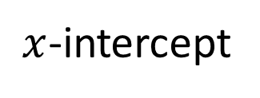
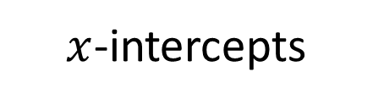
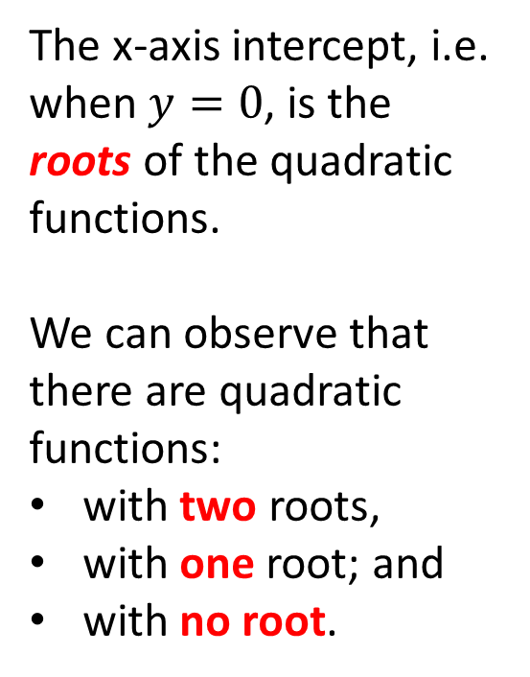
Activating Prior Knowledge
y = ax² + bx + c
y = ax² + bx + c
The x-axis intercept, i.e. when $y=0$, is the roots of the quadratic functions.
We can observe that there are quadratic functions:
with two roots,
with one root; and
with no root.
y
.
.
.
x
$x$-intercepts
$x$-intercept
y = ax² + bx + c

Slide 3
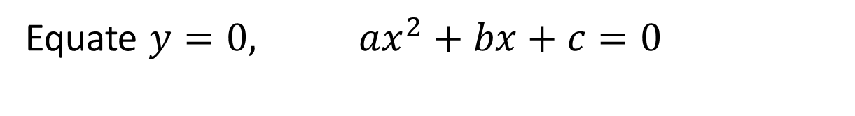

Activating Prior Knowledge
To find solutions of quadratic equations
$$y=ax^{2}+bx+c$$
Find where the equation cuts the x- axis.
Equate $y=0, ax^{2}+bx+c=0$

Slide 4
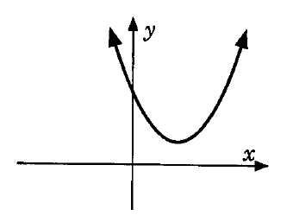
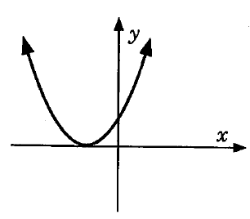
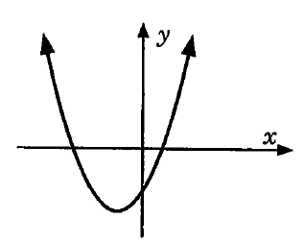
Activating Prior Knowledge
Quadratic Graphs:
Will intersect the $y−$axis. This point is known as the $y−$ intercept
Either: Have 0 solutions/no roots - no $x−$ intercepts
OR: Have 1 solutions/ 1 root - 1$x−$ intercept
OR: Have 2 solutions/ 2 roots - 2$x−$ intercepts

Slide 5
Solving quadratic equation
Skill Development
Solve the quadratic equation
Yes
Can the equation be factorized?
NO
Solve by completing the square
Or by using the quadratic formula

Slide 6
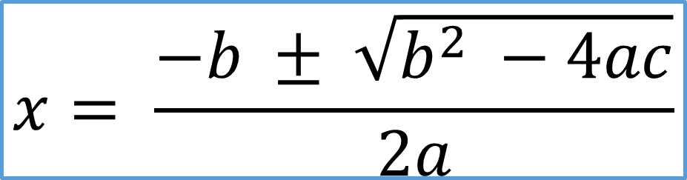
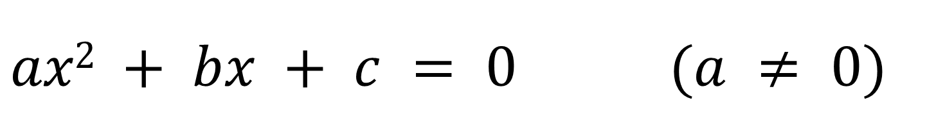
$ax2 + bx + c = 0$ $(a ≠ 0)$
Concept Development
Can be solved by factorization
or by
The quadratic formula
$$x= \frac{−b ± \sqrt{b^{2} −4ac}}{2a}$$

Slide 7

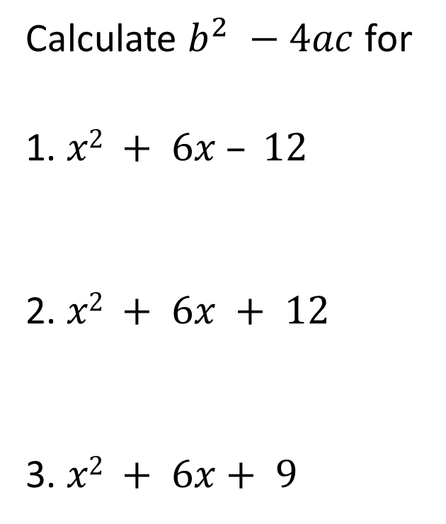
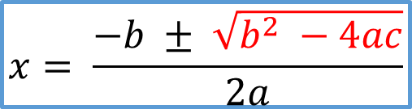

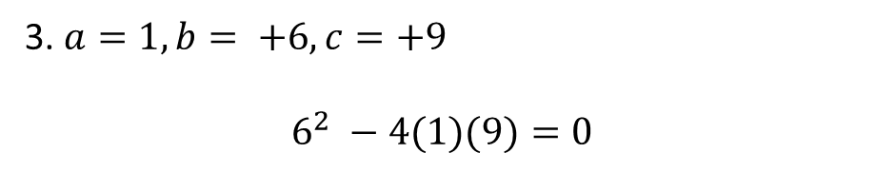
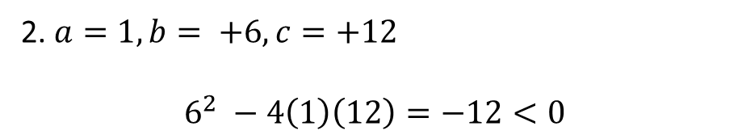

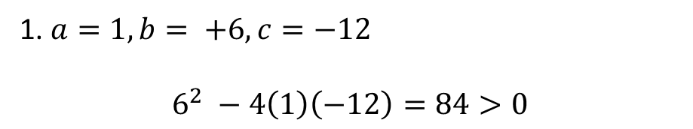

Let’s have a look at $\sqrt{b^{2} −4ac}$
Concept Development
$$x= \frac{−b ± \sqrt{b^{2} −4ac}}{2a}$$
Calculate $b^{2} −4ac$ for
1. $x2 + 6x – 12$
2. $x2 + 6x + 12$
3. $x2 + 6x+ 9$
1. $a=1, b= +6, c=−12$
$$6^{2} −4\left(1\right)\left(−12\right)=84>0$$
$$\text{2 }\text{solutions} \text{or}\text{ 2 }\text{roots}$$
2. $a=1, b= +6, c=+12$
$$6^{2} −4\left(1\right)\left(12\right)=−12<0$$
$$\text{0 }\text{solutions} \text{or}\text{ 0 }\text{roots}$$
3. $a=1, b= +6, c=+9$
$$6^{2} −4(1)(9)=0$$
$$\text{1 }\text{solutions} \text{or}\text{ 1 }\text{root}$$

Slide 8

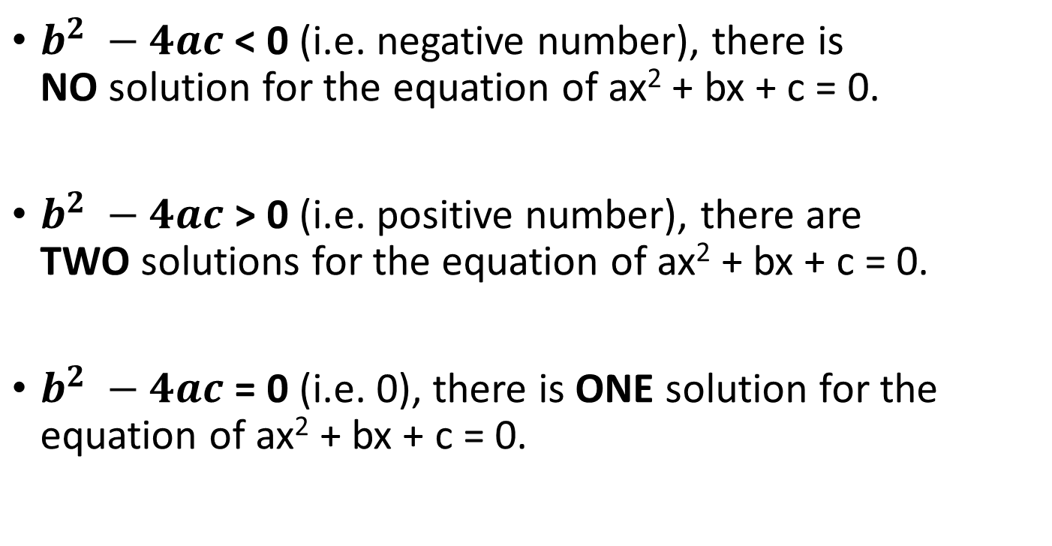
Concept Development
$b^{2} −4ac$ < 0 (i.e. negative number), there is NO solution for the equation of ax² + bx + c = 0.
$b^{2} −4ac$ > 0 (i.e. positive number), there are TWO solutions for the equation of ax² + bx + c = 0.
$b^{2} −4ac$ = 0 (i.e. 0), there is ONE solution for the equation of ax² + bx + c = 0.
Discriminant of the quadratic formula:
$$∆=b^{2} −4ac$$

Slide 9
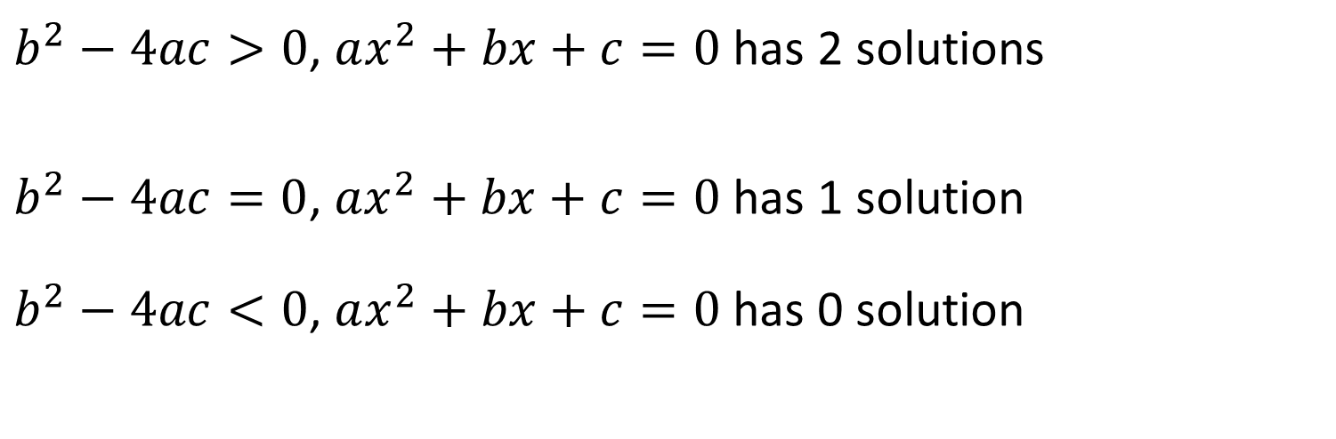

Concept Development
$$x= \frac{−b ± \sqrt{b^{2} −4ac}}{2a}$$
To determine the number of solutions of quadratic equations
$$y=ax^{2}+bx+c$$
$b^{2}−4ac>0$, $ax^{2}+bx+c=0$ has 2 solutions
$b^{2}−4ac=0$, $ax^{2}+bx+c=0$ has 1 solution $b^{2}−4ac<0$, $ax^{2}+bx+c=0$ has 0 solution

Slide 10
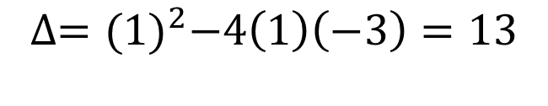
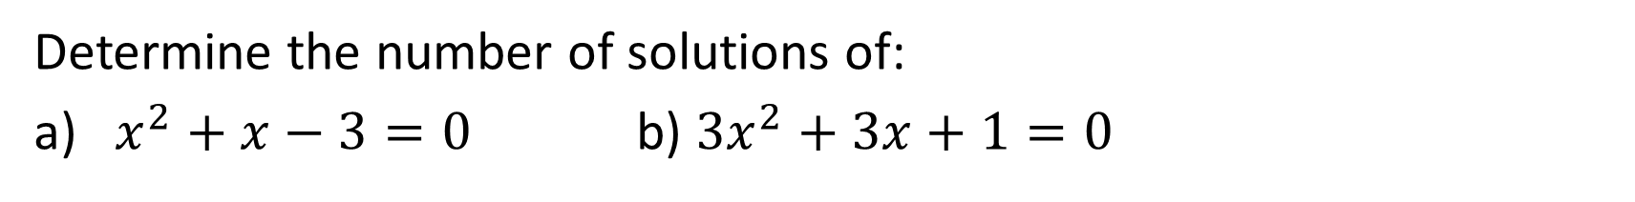


The Discriminant
$$x= \frac{−b ± \sqrt{b^{2} −4ac}}{2a}$$
Determine the number of solutions of:
a) $x^{2}+x−3=0$ b) ${3x}^{2}+3x+1=0$
$$∆={(1)}^{2}−4\left(1\right)\left(−3\right)=13$$
$$>0$$
$∴x^{2}+x−3=0$ has 2 solutions
$$∆=({3)}^{2}−4\left(3\right)\left(1\right)=9−12=−3$$
$$<0$$
$$∴3x^{2}+3x+1=0 \text{has}\text{ 0 }\text{solutions}$$

Slide 11
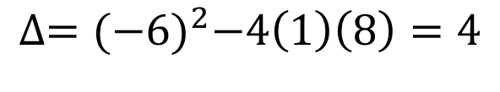

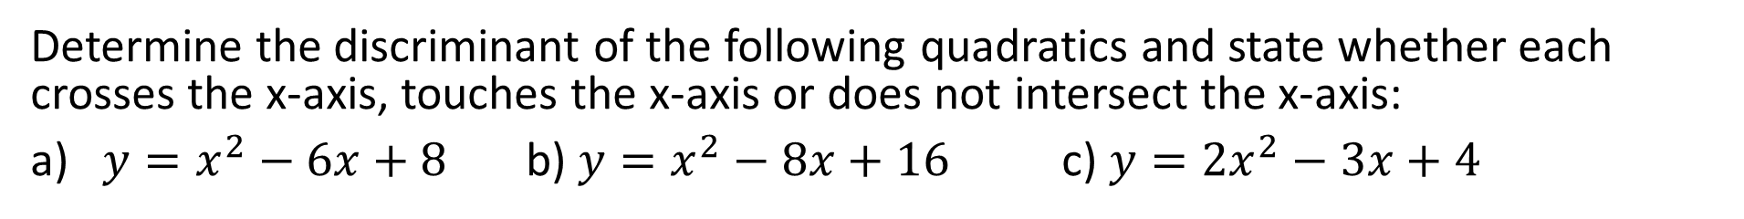

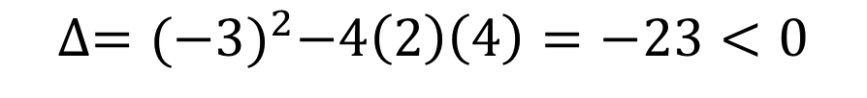
The Discriminant
$$x= \frac{−b ± \sqrt{b^{2} −4ac}}{2a}$$
Determine the discriminant of the following quadratics and state whether each crosses the x-axis, touches the x-axis or does not intersect the x-axis:
a) $y=x^{2}−6x+8$ b) $y=x^{2}−8x+16$ c) $y=2x^{2}−3x+4$
$$∆={(−6)}^{2}−4\left(1\right)\left(8\right)=4$$
$$>0$$
As $∆>0$, there are 2 solutions. The graph intersects the $x$-axis at 2 points.
$$∆={(−8)}^{2}−4\left(1\right)\left(16\right)=0$$
As $∆=0$, there is 1 solutions. The graph touches the $x$-axis at 1 points.
$$∆={(−3)}^{2}−4\left(2\right)\left(4\right)=−23<0$$
As $∆<0$, there are no solutions. The graph does not intersect the $x$-axis.

Slide 12


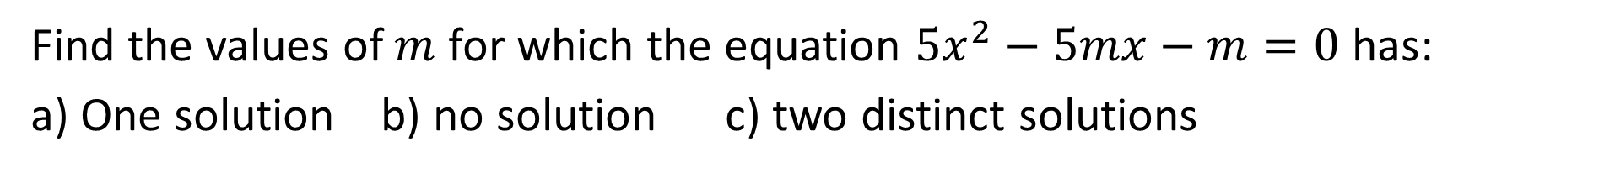




The Discriminant
Find the values of $m$ for which the equation $5x^{2}−5mx−m=0$ has:
a) One solution b) no solution c) two distinct solutions
$$∆={(−5m)}^{2}−4\left(5\right)\left(−m\right) \\ ∆=25m^{2}+20m=5m(5m+4)$$
G$raph ∆=25m^{2}+20m$
At one solution, $∆=0$,
$$5m(5m+4)=0$$
$$m=0, m=−\frac{4}{5}$$
At no solution, $∆<0$,
From the graph, $−\frac{4}{5}<m<0$
At 2 solution, $∆>0$,
From the graph, $m>0 or m<−\frac{4}{5}$

Slide 13
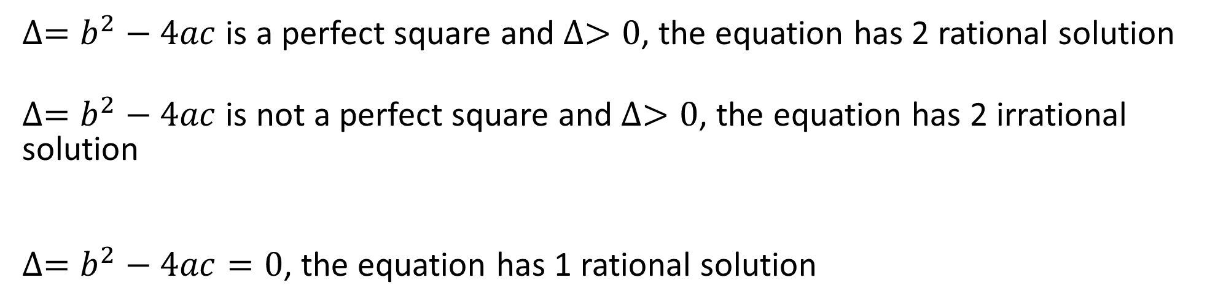

Concept Development
To determine the nature of solutions of quadratic equations
$$y=ax^{2}+bx+c$$
$∆=b^{2}−4ac$ is a perfect square and $∆>0$, the equation has 2 rational solution
$∆=b^{2}−4ac$ is not a perfect square and $∆>0$, the equation has 2 irrational solution
$∆=b^{2}−4ac=0$, the equation has 1 rational solution

Slide 14

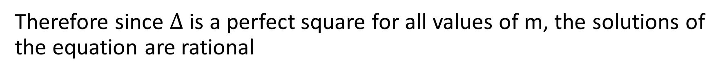

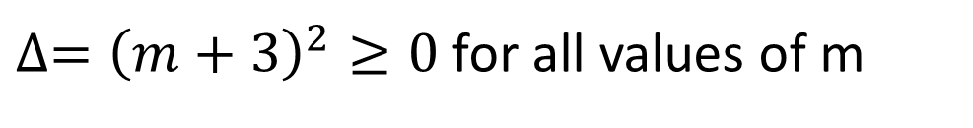


The Discriminant
Show that the solutions of the equation $3x^{2}+\left(m−3\right)x−m=0$ are rational for all rational values of the equation $m.$
$$∆={\left(m−3\right)}^{2}−4(3)(−m)$$
$$∆=m^{2}−6m+9+12m$$
$$∆=m^{2}+6m+9$$
$∆={\left(m+3\right)}^{2}≥0$ for all values of m
Therefore since $∆$ is a perfect square for all values of m, the solutions of the equation are rational

Slide 15
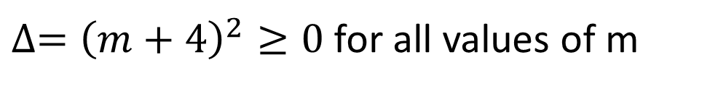

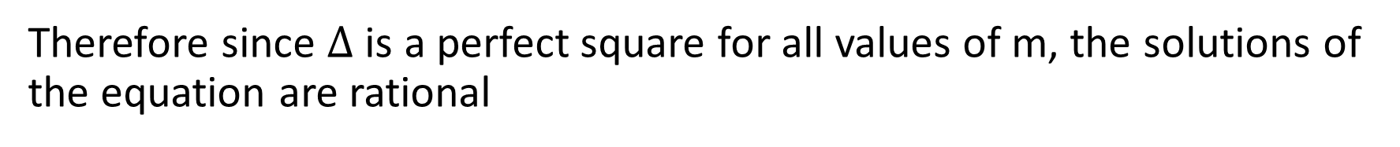
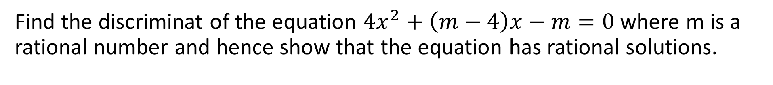
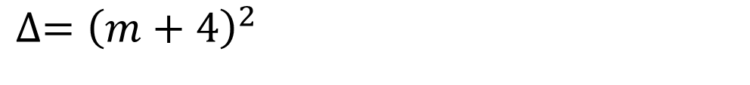


The Discriminant
Find the discriminat of the equation $4x^{2}+\left(m−4\right)x−m=0$ where m is a rational number and hence show that the equation has rational solutions.
$$∆={\left(m−4\right)}^{2}−4(4)(−m)$$
$$∆=m^{2}−8m+16+16m$$
$$∆=m^{2}+8m+16$$
$$∆={\left(m+4\right)}^{2}$$
$∆={\left(m+4\right)}^{2}≥0$ for all values of m
Therefore since $∆$ is a perfect square for all values of m, the solutions of the equation are rational

Slide 16


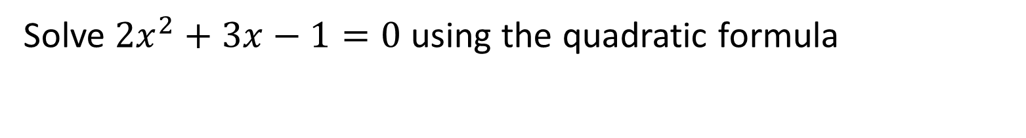

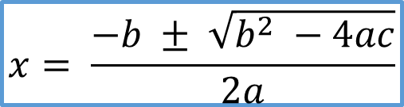
Guided Practice
$$x= \frac{−b ± \sqrt{b^{2} −4ac}}{2a}$$
Solve $2x^{2}+3x−1=0$ using the quadratic formula
$$x=\frac{−3±\sqrt{3^{2}−4\left(2\right)\left(−1\right)}}{2\left(2\right)}$$
$$x=\frac{−3±\sqrt{17}}{4}$$
$$x=\frac{−3+\sqrt{17}}{4} \text{or} x=\frac{−3−\sqrt{17}}{4} \\ x=0.28 or x=−1.78$$

Slide 17




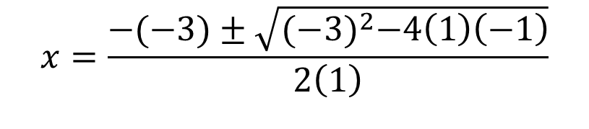
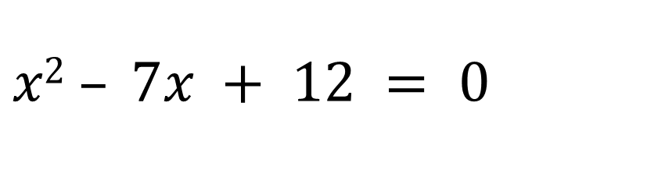
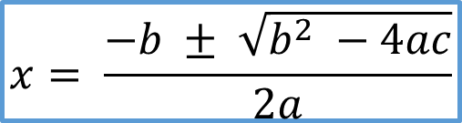

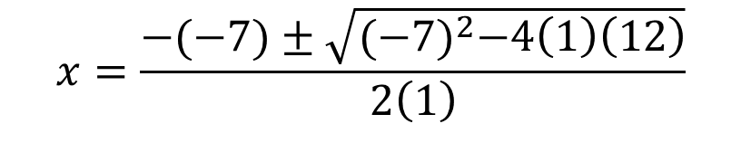

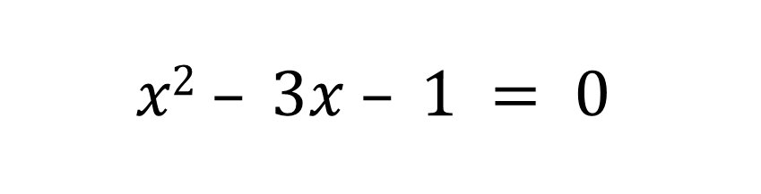
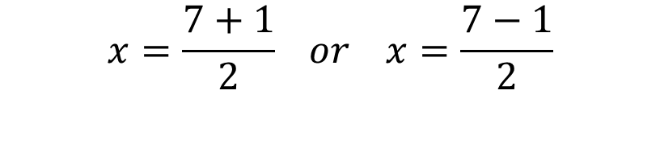

$$x2 – 7x + 12 = 0$$
Guided Practice
$$x= \frac{−b ± \sqrt{b^{2} −4ac}}{2a}$$
$$x2 – 3x – 1 = 0$$
$$a = 1, b = −7, c = 12$$
$$a = 1, b = −3, c =−1$$
$$x=\frac{−(−7)±\sqrt{{(−7)}^{2}−4\left(1\right)\left(12\right)}}{2\left(1\right)}$$
$$x=\frac{−(−3)±\sqrt{{(−3)}^{2}−4\left(1\right)\left(−1\right)}}{2\left(1\right)}$$
$$x=\frac{3±\sqrt{9+4}}{2}$$
$$x=\frac{7±\sqrt{49−48}}{2}$$
$$x=\frac{7±\sqrt{1}}{2}$$
$$x=\frac{3±\sqrt{13}}{2}$$
$$x=\frac{7+1}{2} or x=\frac{7−1}{2}$$
$$x=4 or x=3$$

Slide 18
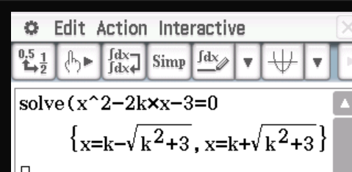




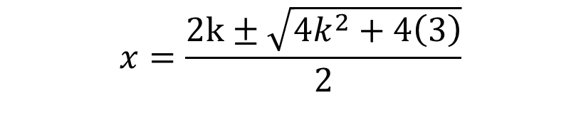
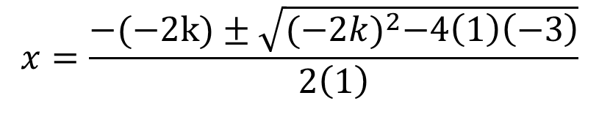
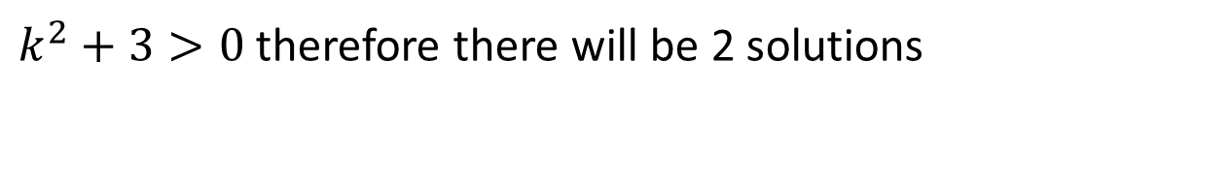
Solve $x2 –2kx −3 = 0$ and determine how many solutions there are.
Guided Practice
$$x= \frac{−b ± \sqrt{b^{2} −4ac}}{2a}$$
$$a =1, b = −2k, c =−3$$
$$x=\frac{−(−2k)±\sqrt{{(−2k)}^{2}−4\left(1\right)\left(−3\right)}}{2\left(1\right)}$$
$$x=\frac{2k±\sqrt{{4k}^{2}+4\left(3\right)}}{2}$$
$$x=\frac{2k±2\sqrt{k^{2}+3}}{2}$$
$$x=k±\sqrt{k^{2}+3}$$
$k^{2}+3>0$ therefore there will be 2 solutions

Slide 19
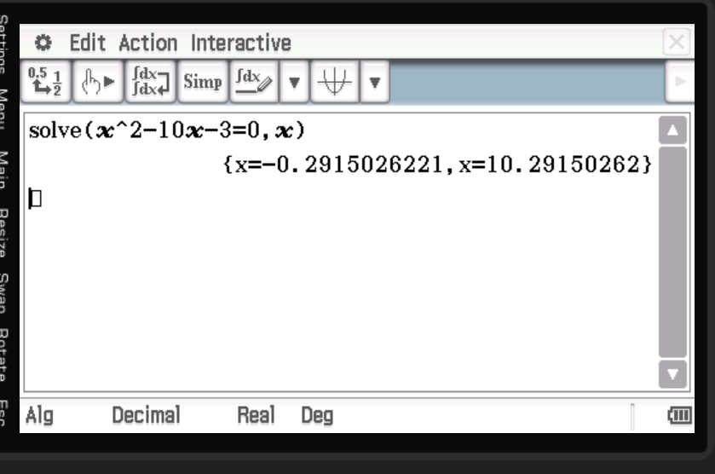
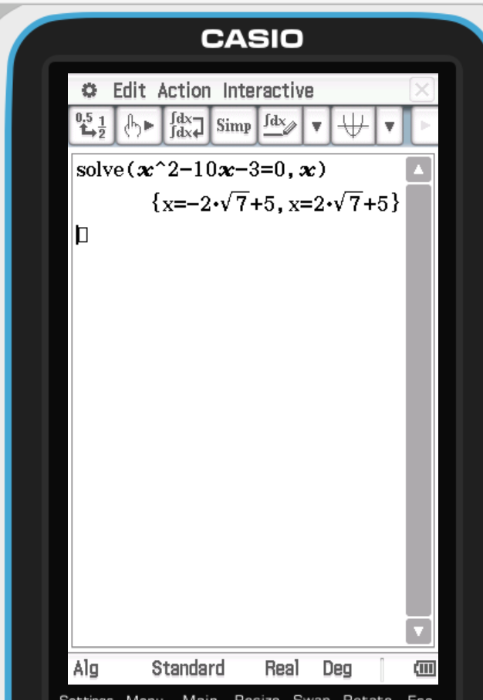
Using classpad to solve $x2 – 10x – 3 = 0$
Guided Practice

Slide 20
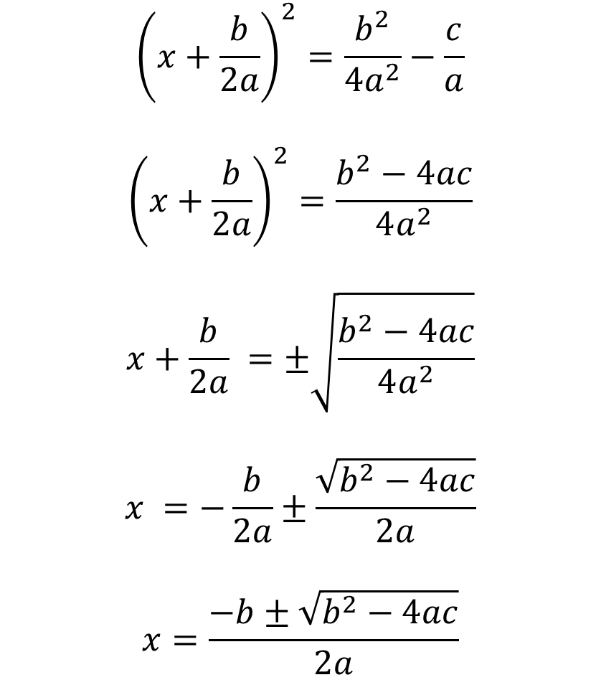
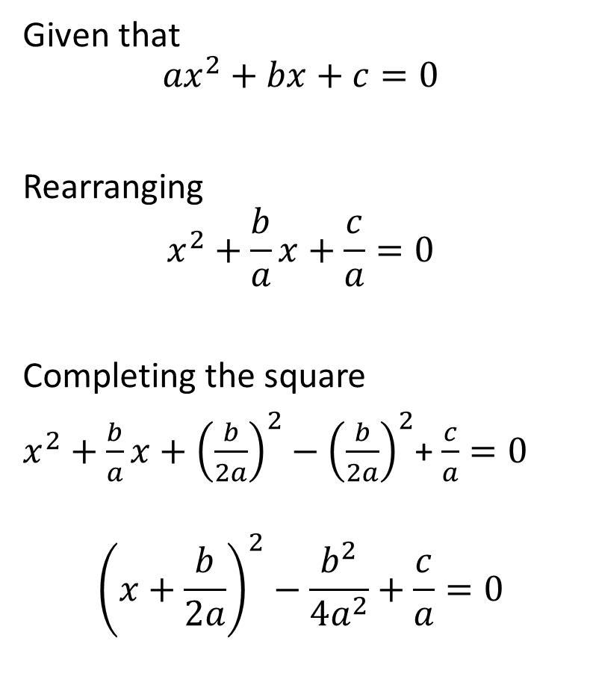
Deriving the quadratic formula
Extension knowledge
$${\left(x+\frac{b}{2a}\right)}^{2}=\frac{b^{2}}{4a^{2}}−\frac{c}{a}$$
$${\left(x+\frac{b}{2a}\right)}^{2}=\frac{b^{2}−4ac}{4a^{2}}$$
$$x+\frac{b}{2a} =±\sqrt{\frac{b^{2}−4ac}{4a^{2}}}$$
$$x =−\frac{b}{2a}±\frac{\sqrt{b^{2}−4ac}}{2a}$$
$$x=\frac{−b±\sqrt{b^{2}−4ac}}{2a}$$
Given that
$${ax}^{2}+bx+c=0$$
Rearranging
$$x^{2}+\frac{b}{a}x+\frac{c}{a}=0$$
Completing the square
$x^{2}+\frac{b}{a}x+{\left(\frac{b}{2a}\right)}^{2}−$ ${\left(\frac{b}{2a}\right)}^{2}$+ $\frac{c}{a}=0$
$${\left(x+\frac{b}{2a}\right)}^{2}−\frac{b^{2}}{4a^{2}}+\frac{c}{a}=0$$

Slide 21
Independent Practice
Cambridge Ex 3H & 3I

